Slide 1

Website Title:

Slide 2

Website Purpose
(Name of our Website) e-commerce platform that primarily focuses on fashion and clothing and others. Its purpose is to provide consumers with a wide range of trendy and affordable clothing, accessories, and fashion items.

Slide 3

Target Audience
Individuals who are interested in fashion and are looking for trendy, affordable clothing and accessories.
Young Adults and Millennials
Fashion Enthusiasts
Students
Online Shopper
Social Media Users
Fashion Bloggers and Influencers
Global Audience
Budget Conscious Shoppers

Slide 4
Site Map
WM
Website
Men’s
Women’s
Kids
Profile
Favorites
Cart
page
page
page
Log-in & Sign-up
Fav page
Add to Cart page
Product Listing Pg.
Login Page.
Sign Up
Single Product

Slide 5
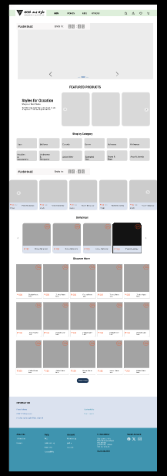
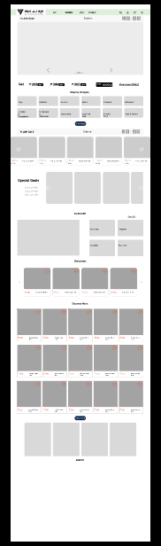
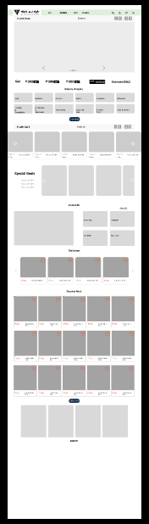
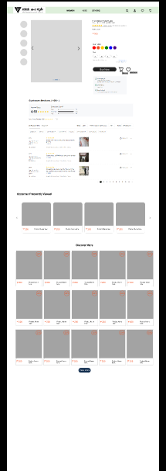
Mock-up pg.1
https://www.figma.com/proto/A0dajzEb2mdkDyiGZXNFcM/WireFrame?page-id=0%3A1&type=design&node-id=30-4&viewport=-168%2C-91%2C0.15&t=B1BrCrYItLfzcwhm-1&scaling=scale-down-width&mode=design

Slide 6
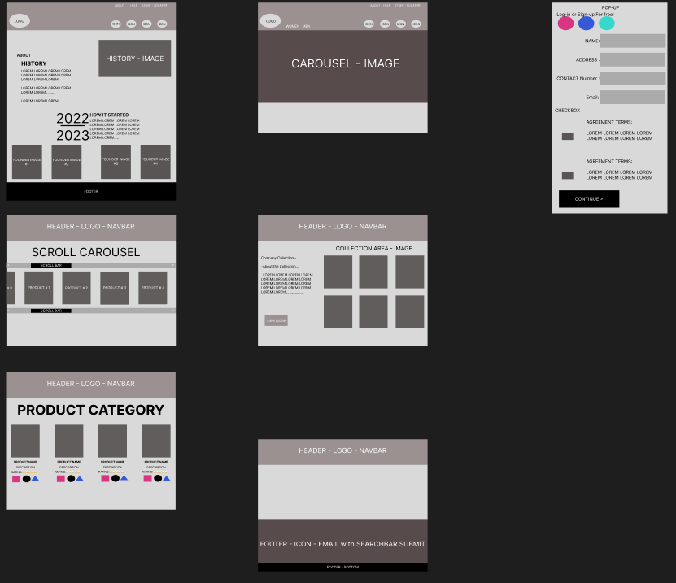
Mock up pg.2

Slide 7
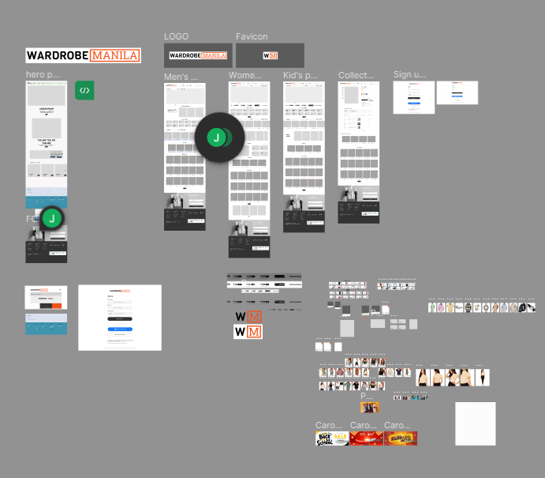

Slide 8
Color Pallettes
#0b0c0c
##ffffffff
#f1511b
#333333

Slide 9
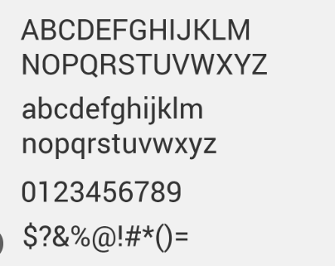
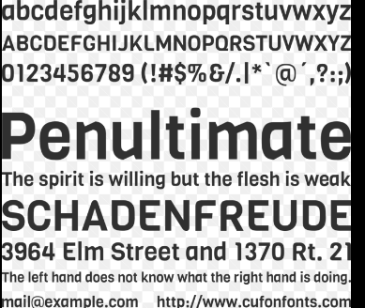
Font(s)
Roboto
Viga

